Slide 1



Exposure Java-AB 2007
Chapter 35 Slides
Binary Trees
PowerPoint Presentation
created by:
Mr. John L. M. Schram
From Materials Created
by Mr. Leon Schram

Slide 2
Tree
Vocabulary

Slide 3



Trees
A tree is a data structure that starts with
a root node that can be linked to 1 or more additional nodes. Furthermore, each node can be linked to one or more additional nodes.
Root
N1
N2
N3
N4
N5
N6
N7
N8
N9

Slide 4
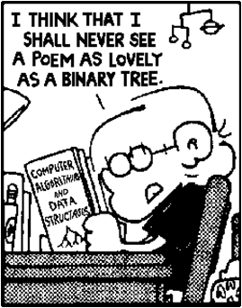
Binary Trees
A binary tree is a tree data structure, in which each node can be linked to no more than 2 other nodes, called left child and right child.
Root
 | N1
 | N2
 | N3
 | N4
 | N5
 | N6
 | N7

Slide 5


Binary Tree Vocabulary - Root
The root is the top node of a binary tree; it is the start of the binary tree; it is the single node of the tree that allows access to all other nodes. Binary trees are, traditionally, drawn upside down in pyramid fashion.
Root
 | N1
 | N2
 | N3
 | N4
 | N5
 | N6
 | N7

Slide 6
Binary Tree Vocabulary - Level
A binary tree has different levels. The root is always level-0. The nodes connected to the root, N2 and N3, are at level-1. N4, N5, N6 and N7 are all at level-2.
Level 0
 | N1
Root
Level 1
 | N2
 | N3
Level 2
 | N4
 | N5
 | N6
 | N7

Slide 7
Binary Tree Vocabulary – Tree Node
A tree node is a single element in a binary tree.
This node can be at any location in the tree.
The tree node includes the data, as well as references to other nodes at a lower level in the tree.
 | N1
 | N2
 | N3
 | N4
 | N5
 | N6
 | N7

Slide 8





Binary Tree Vocabulary – Children
Nodes N2 and N3 are both children of the root, N1. Nodes N4 and N5 are children of node N2 and nodes N6 and N7 are children or node N3.
 | N1
 | N2
 | N3
 | N4
 | N5
 | N6
 | N7

Slide 9


Binary Tree Vocabulary – Parents
N1 is the parent of N2 and N3. Even though N2 is a child of N1, it is at the same time the parent of N4 and N5. Likewise, N3 is the parent of N6 and N7.
 | N1
 | N2
 | N3
 | N4
 | N5
 | N6
 | N7

Slide 10
Left Children & Right Children
N2 is the left child of N1.
N3 is the right child of N1.
 | N1
 | N2
 | N3
 | N4
 | N5
 | N6
 | N7

Slide 11
Siblings & Cousins
N2 and N3 are siblings, as are N4 and N5. N5 and N6 are on the same level, but they are not siblings, since they do not share a common parent. You could say that N5 and N6 are the same generation or cousins.
 | N1
 | N2
 | N3
 | N4
 | N5
 | N6
 | N7

Slide 12

Ancestors
N1 is the ancestor of all the nodes that follow.
An ancestor is either a parent of the node, or
grand parent, or great grand parent and so on.
The ancestors of N6 are N3 and N1.
 | N1
 | N2
 | N3
 | N4
 | N5
 | N6
 | N7

Slide 13




Descendants
Descendants are children of a node or grand children, or great grand children and so on.
N1’s descendants are all
the other nodes in the tree.
 | N1
 | N2
 | N3
 | N4
 | N5
 | N6
 | N7

Slide 14
Subtree
Any node in a tree, and all its descendants is a subtree. In such a case the given node becomes the root of the subtree. The subtree, which starts with N2 includes N2 as the root and the descendants N4 and N5. The left subtree of N1 starts with N2 and the right subtree of N1 starts with N3.
 | N1
 | N2
 | N3
 | N4
 | N5
 | N6
 | N7

Slide 15



Leaf
A node without any children is called a leaf.
N4, N5, N6 and N7 are all leaves.
 | N1
 | N2
 | N3
 | N4
 | N5
 | N6
 | N7

Slide 16


Path
A path in a binary tree is a
sequence of nodes with each
node the parent of the next node in the path.
N4 – N2 – N1 is an example of a path.
 | N1
 | N2
 | N3
 | N4
 | N5
 | N6
 | N7

Slide 17


Branch
A branch is the path that extends from the root of a tree to a leaf. A branch can also start in a subtree with the same meaning. The node that starts the subtree becomes its virtual root. N1 – N2 – N4 is an example of a branch.
 | N1
 | N2
 | N3
 | N4
 | N5
 | N6
 | N7

Slide 18

Height
The height of a binary tree is measured by counting the number of nodes in the longest possible path from the root of the tree to any of its leaves. The height is the same as the number of levels in a binary tree.
The height of the tree below is 3.
 | N1
 | N2
 | N3
 | N4
 | N5
 | N6
 | N7

Slide 19
Another Height Example
Root
Level 0
500
This binary tree has a height of 5. It is true that the last level is Level 4, but the height refers to number of levels.
This is similar to an array. The size or length of an array is always one greater that the maximum index. And the first index, like the first level, is always 0.
Level 1
300
700
Level 2
200
400
600
800
150
250
350
550
750
850
Level 3
Level 4
575
825

Slide 20

Tom
Sue
Joe
Meg
Ann
Linked Lists have some major advantages over arrays, but can you do a Binary Search on a Linked List?

Slide 21

Binary Search Trees
A binary search tree is a binary tree, in which the left child, if it exists, contains a lesser value than the parent. The right child, if it exists, contains a greater value than the parent.
Root
 | 45
 | 16
 | 72
 | 8
 | 43
 | 68
 | 97

Slide 22
Another Binary Search Tree
Root
500
300
700
200
400
600
800
150
250
350
550
750
850
The majority of the program examples in this chapter will be using binary search trees that store int values.
575
825

Slide 23
Declaring a Binary Tree Node that stores Objects
class TreeNode
{
public TreeNode(Object initValue, TreeNode initLeft, TreeNode initRight)
{
value = initValue;
left = initLeft;
right = initRight;
}
public Object getValue() { return value; }
public TreeNode getLeft() { return left; }
public TreeNode getRight() { return right; }
public void setValue(Object theNewValue) { value = theNewValue; }
public void setLeft(TreeNode theNewLeft) { left = theNewLeft; }
public void setRight(TreeNode theNewRight) { right = theNewRight; }
private Object value;
private TreeNode left;
private TreeNode right;
}

Slide 24
Declaring a Binary Tree Node that stores ints
class TreeNode
{
public TreeNode(int initValue, TreeNode initLeft, TreeNode initRight)
{
value = initValue;
left = initLeft;
right = initRight;
}
public int getValue() { return value; }
public TreeNode getLeft() { return left; }
public TreeNode getRight() { return right; }
public void setValue(int theNewValue) { value = theNewValue; }
public void setLeft(TreeNode theNewLeft) { left = theNewLeft; }
public void setRight(TreeNode theNewRight) { right = theNewRight; }
private int value;
private TreeNode left;
private TreeNode right;
}

Slide 25
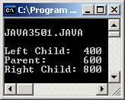
// Java3501.java
// This program creates a three-noded binary tree.
// Each tree node is accessed directly with its own
// reference variable.
public class Java3501
{
public static void main(String args[])
{
System.out.println("\nJAVA3501.JAVA\n");
TreeNode t1 = new TreeNode(400,null,null);
TreeNode t2 = new TreeNode(800,null,null);
TreeNode root = new TreeNode(600,t1,t2);
System.out.println("Left Child: " + t1.getValue());
System.out.println("Parent: " + root.getValue());
System.out.println("Right Child: " + t2.getValue());
System.out.println();
}
}
Root
 | 600
 | 400
 | 800

Slide 26
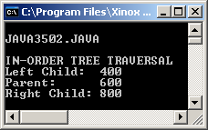
// Java3502.java
// This program accesses the left-child and right-child
// nodes indirectly from the root node and performs
// an inorder tree traversal.
public class Java3502
{
public static void main(String args[])
{
System.out.println("\nJAVA3502.JAVA\n");
TreeNode t1 = new TreeNode(400,null,null);
TreeNode t2 = new TreeNode(800,null,null);
TreeNode root = new TreeNode(600,t1,t2);
System.out.println("IN-ORDER TREE TRAVERSAL");
System.out.println("Left Child: " + root.getLeft().getValue());
System.out.println("Parent: " + root.getValue());
System.out.println("Right Child: " + root.getRight().getValue());
System.out.println();
}
}
Root
 | 600
 | 400
 | 800

Slide 27
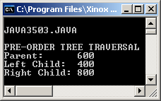
// Java3503.java
// This program accesses the left-child and right-child nodes
// indirectly from the root node and performs a preorder
// tree traversal.
public class Java3503
{
public static void main(String args[])
{
System.out.println("\nJAVA3503.JAVA\n");
TreeNode t1 = new TreeNode(400,null,null);
TreeNode t2 = new TreeNode(800,null,null);
TreeNode root = new TreeNode(600,t1,t2);
System.out.println("PRE-ORDER TREE TRAVERSAL");
System.out.println("Parent: " + root.getValue());
System.out.println("Left Child: " + root.getLeft().getValue());
System.out.println("Right Child: " + root.getRight().getValue());
System.out.println();
}
}
Root
 | 600
 | 400
 | 800

Slide 28
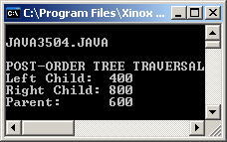
// Java3504.java
// This program accesses the left-child and right-child nodes
// indirectly from the root node and performs a postorder
// tree traversal.
public class Java3504
{
public static void main(String args[])
{
System.out.println("\nJAVA3504.JAVA\n");
TreeNode t1 = new TreeNode(400,null,null);
TreeNode t2 = new TreeNode(800,null,null);
TreeNode root = new TreeNode(600,t1,t2);
System.out.println("POST-ORDER TREE TRAVERSAL");
System.out.println("Left Child: " + root.getLeft().getValue());
System.out.println("Right Child: " + root.getRight().getValue());
System.out.println("Parent: " + root.getValue());
System.out.println();
}
}
Root
 | 600
 | 400
 | 800

Slide 29
In-order, pre-order and post-order? Does that have anything to do with in-fix, pre-fix and post-fix notations?

Slide 30
Traversing a Linked List
A linked list, like the one below, can be traversed with a simple while loop.
while (first != null)
{
System.out.println(first.getValue());
first = first.getNext();
}
Tom
Sue
Joe
Meg
Ann
first

Slide 31






How would you traverse this?
The answer is...
Root
500
RECURSION
300
700
200
400
600
800
150
250
350
550
750
850
575
825

Slide 32
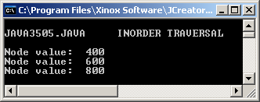
// Java3505.java
// This program demonstrates inorder tree traversal with a
// recursive tree traversal method.
public class Java3505
{
public static void main(String args[])
{
System.out.println("\nJAVA3505.JAVA INORDER TRAVERSAL\n");
TreeNode t1 = new TreeNode(400,null,null);
TreeNode t2 = new TreeNode(800,null,null);
TreeNode root = new TreeNode(600,t1,t2);
traverseInOrder(root);
System.out.println();
}
public static void traverseInOrder(TreeNode p)
{
if (p != null)
{
traverseInOrder(p.getLeft());
System.out.println("Node value: " + p.getValue());
traverseInOrder(p.getRight());
}
}
}
 | 600
Root
 | 400
 | 800

Slide 33
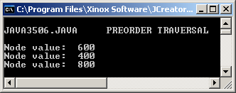
// Java3506.java
// This program demonstrates preorder tree traversal with a
// recursive tree traversal method.
public class Java3506
{
public static void main(String args[])
{
System.out.println("\nJAVA3506.JAVA PREORDER TRAVERSAL\n");
TreeNode t1 = new TreeNode(400,null,null);
TreeNode t2 = new TreeNode(800,null,null);
TreeNode root = new TreeNode(600,t1,t2);
traversePreOrder(root);
System.out.println();
}
public static void traversePreOrder(TreeNode p)
{
if (p != null)
{
System.out.println("Node value: " + p.getValue());
traversePreOrder(p.getLeft());
traversePreOrder(p.getRight());
}
}
}
 | 600
Root
 | 400
 | 800

Slide 34

// Java3507.java
// This program demonstrates postorder tree traversal with a
// recursive tree traversal method.
public class Java3507
{
public static void main(String args[])
{
System.out.println("\nJAVA3507.JAVA POSTORDER TRAVERSAL\n");
TreeNode t1 = new TreeNode(400,null,null);
TreeNode t2 = new TreeNode(800,null,null);
TreeNode root = new TreeNode(600,t1,t2);
traversePostOrder(root);
System.out.println();
}
public static void traversePostOrder(TreeNode p)
{
if (p != null)
{
traversePostOrder(p.getLeft());
traversePostOrder(p.getRight());
System.out.println("Node value: " + p.getValue());
}
}
}
 | 600
Root
 | 400
 | 800

Slide 35
How would you display the contents of a Binary Search Tree in REVERSE order?

Slide 36
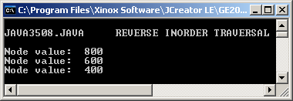
// Java3508.java
// This program demonstrates reverse-inorder tree
// traversal with a recursive tree traversal method.
public class Java3508
{
public static void main(String args[])
{
System.out.println("\nJAVA3508.JAVA REVERSE INORDER TRAVERSAL\n");
TreeNode t1 = new TreeNode(400,null,null);
TreeNode t2 = new TreeNode(800,null,null);
TreeNode root = new TreeNode(600,t1,t2);
traverseReverseInOrder(root);
System.out.println();
}
public static void traverseReverseInOrder(TreeNode p)
{
if (p != null)
{
traverseReverseInOrder(p.getRight());
System.out.println("Node value: " + p.getValue());
traverseReverseInOrder(p.getLeft());
}
}
}
 | 600
Root
 | 400
 | 800

Slide 37
Tree
Traversals

Slide 38
In-Order Tree Traversal
An in-order traversal is a binary tree traversal that visits each node in the binary tree with the sequence:
Left Child - - - Parent - - - Right Child
public static void traverseInOrder(TreeNode p)
{
if (p != null)
{
traverseInOrder(p.getLeft());
System.out.println("Node value: " + p.getValue());
traverseInOrder(p.getRight());
}
}

Slide 39
Pre-Order Tree Traversal
A pre-order traversal is a binary tree traversal that visits each node in the binary tree with the sequence:
Parent - - - Left Child - - - Right Child
public static void traversePreOrder(TreeNode p)
{
if (p != null)
{
System.out.println("Node value: " + p.getValue());
traversePreOrder(p.getLeft());
traversePreOrder(p.getRight());
}
}

Slide 40
Post-Order Tree Traversal
A post-order traversal is a binary tree traversal that visits each node in the binary tree with the sequence:
Left Child - - - Right Child - - - Parent
public static void traversePostOrder(TreeNode p)
{
if (p != null)
{
traversePostOrder(p.getLeft());
traversePostOrder(p.getRight());
System.out.println("Node value: " + p.getValue());
}
}

Slide 41
Rev-Order Tree Traversal
A reverse in-order traversal is a binary tree traversal that visits each node in the binary tree with the sequence:
Right Child - - - Parent - - - Left Child
public static void traverseInOrder(TreeNode p)
{
if (p != null)
{
traverseInOrder(p.getRight());
System.out.println("Node value: " + p.getValue());
traverseInOrder(p.getLeft());
}
}

Slide 42
Why We Use Recursion
The main reason why recursion is beneficial in computer programs is to simplify the program source code of certain complex algorithms.

Slide 43

3 Recursion Fundamentals
1. Every recursive method must have an exit or base case.
2. Every method must be finished when interrupted by a recursive call
3. The sequence of unfinished method business is handled like a LIFO.

Slide 44
// Java3509.java
// This program creates a binary search tree (BST) with 40 random integer
// values. The values are then displayed with an inorder traversal.
import java.util.Random;
public class Java3509
{
public static void main(String args[])
{
System.out.println("\nJAVA3509.JAVA\n");
TreeNode root = createBST();
System.out.println("\n\n");
traverseInOrder(root);
System.out.println();
}
public static void traverseInOrder(TreeNode p)
{
if (p != null)
{
traverseInOrder(p.getLeft());
System.out.print(p.getValue() + " ");
traverseInOrder(p.getRight());
}
}
Method createBST
and the output are
on the next 2 slides.

Slide 45
public static TreeNode createBST()
{
Random rndObj = new Random(12345);
int rndInt = rndObj.nextInt(9000) + 1000;
TreeNode t1 = null, t2 = null, t3 = null; // #1
TreeNode root = new TreeNode(rndInt,null,null); // #2
System.out.print(root.getValue() + " "); // #3
t2 = t3 = root; // #4
for (int k = 2; k <= 40; k++) // #5
{
rndInt = rndObj.nextInt(9000) + 1000; // #6
t1 = new TreeNode(rndInt,null,null);; // #7
System.out.print(t1.getValue() + " "); // #8
while (t2 != null) // #9
{
t3 = t2; // #10
if (t1.getValue() > t2.getValue()) // #11
t2 = t2.getRight(); // #12
else
t2 = t2.getLeft(); // #13
}
if (t1.getValue() > t3.getValue()) // #14
t3.setRight(t1); // #15
else
t3.setLeft(t1); // #16
t2 = root; // #17
}
return root; // #18
}
}

Slide 46
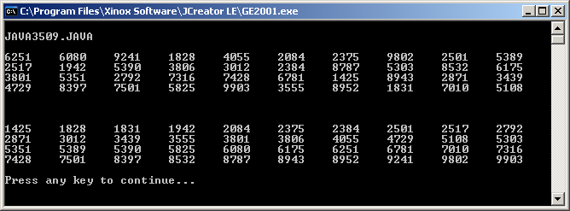

Slide 47
The Binary Tree Sort
You may have noticed that in the previous program, when the numbers were displayed the second time, they were sorted.
This happened because a Binary Tree Sort was used.
2 Steps to the Binary Tree Sort:
1st Put all of the numbers in a Binary Search Tree
2nd Display them with an in-order tree traversal
This sort is about as fast as the Merge Sort and MUCH, MUCH faster than the Bubble Sort, Selection Sort, or Insertion Sort.

Slide 48
How would you display the contents of a Binary Search Tree in LEVEL order? (Meaning top to bottom)

Slide 49
Level Order Traversal Example
Root
Level 0
500
Level 1
300
700
Level 2
200
400
600
800
150
250
350
550
750
850
Level 3
Level 4
575
825
A level-order traversal of this tree would be
500 300 700 200 400 600 800 150 250 350 550 750 850 575 825

Slide 50
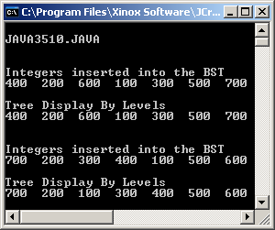
// Java3510.java
// This program demonstrate the use of the iterative <levelTraverse> method
// with the aid of the Queue interface (with LinkedList implementation).
import java.util.*;
public class Java3510 { public static void main(String args[]) { System.out.println("\nJAVA3510.JAVA\n"); System.out.println(); int[] list1 = {400,200,600,100,300,500,700}; TreeNode root1 = createBST(list1); System.out.println(); levelTraverse(root1); System.out.println("\n\n"); int[] list2 = {700,200,300,400,100,500,600}; TreeNode root2 = createBST(list2); System.out.println(); levelTraverse(root2); System.out.println("\n\n"); } | public static void levelTraverse(TreeNode p) { Queue temp = new LinkedList(); if (p == null) System.out.println("THE TREE IS EMPTY"); else { System.out.println("Tree Display By Levels"); temp.add(p); while (!temp.isEmpty()) { p = (TreeNode) temp.remove(); System.out.print(p.getValue() + " "); if (p.getLeft() != null) temp.add(p.getLeft()); if (p.getRight() != null) temp.add(p.getRight()); } } } }

Slide 51


Level-Order Tree Traversal
A level-order tree traversal is a binary tree traversal that visits every node in a binary tree, starting at the root, and then continues with each level of the binary tree.
Each level in the tree is traversed from left to right.
This is made possible by using a Queue data structure.
temp.add(p);
while (!temp.isEmpty())
{
p = (TreeNode) temp.remove();
System.out.print(p.getValue() + " ");
if (p.getLeft() != null)
temp.add(p.getLeft());
if (p.getRight() != null)
temp.add(p.getRight());
}

Slide 52
Deleting a
Node from a
Binary Search Tree

Slide 53
3 Possible Cases for Deleting a Node from a Binary tree
1. Delete a leaf
2. Delete a parent with one child
3. Delete a parent with two children

Slide 54
Case 1 - Step 1
Deleting a Leaf
Root
 | D
 | B
 | E
 | A
 | C
 | F

Slide 55
Case 1 - Step 2
Deleting a Leaf
Root
 | D
 | B
 | E
 | A
 | C
 | F

Slide 56
Case 2 - Step 1
Deleting a Parent with 1 Child
Root
 | D
 | B
 | E
 | A
 | C
 | F

Slide 57
Case 2 - Step 2
Deleting a Parent with 1 Child
Root
 | D
 | B
 | E
 | A
 | C
 | F

Slide 58
Case 2 - Step 3
Deleting a Parent with 1 Child
Root
 | D
 | B
 | E
 | A
 | C
 | F

Slide 59
Case 2 - Step 4
Deleting a Parent with 1 Child
Root
 | D
 | B
 | F
 | A
 | C

Slide 60
Case 3
Deleting a Parent with 2 Children
Root
 | D
 | B
 | E
 | A
 | C
 | F
You can't just remove this node.

Slide 61
Case 3 - Step 1
Deleting a Parent with 2 Children
Root
 | D
 | B
 | E
 | A
 | C
 | F
Find a node to take its place.

Slide 62
Case 3 - Step 2
Deleting a Parent with 2 Children
Root
 | D
 | C
 | E
 | A
 | C
 | F
Copy the DATA from the leaf node.

Slide 63
Case 3 - Step 3
Deleting a Parent with 2 Children
Root
 | D
 | C
 | E
 | A
 | C
 | F
Delete the leaf node instead.

Slide 64
Alternate Case 3
Deleting a Parent with 2 Children
Root
 | D
 | B
 | E
 | A
 | C
 | F
You can't just remove this node.

Slide 65
Alternate Case 3 - Step 1
Deleting a Parent with 2 Children
Root
 | D
 | B
 | E
 | A
 | C
 | F
This node can be used as well.

Slide 66
Alternate Case 3 - Step 2
Deleting a Parent with 2 Children
Root
 | D
 | A
 | E
 | A
 | C
 | F
Copy the DATA from the leaf node.

Slide 67
Alternate Case 3 - Step 3
Deleting a Parent with 2 Children
Root
 | D
 | A
 | E
 | A
 | C
 | F
Delete the leaf node instead.

Slide 68
A Bigger Case 3 Example
Deleting the Root of this Tree
500
300
700
200
400
600
800
150
250
350
550
750
850
575
825

Slide 69
A Bigger Case 3 Example
Deleting the Root of this Tree - Step 1
500
300
700
200
400
600
800
150
250
350
550
750
850
To find the proper replacement node,
First move one node to the left.
575
825

Slide 70
A Bigger Case 3 Example
Deleting the Root of this Tree - Step 2
500
300
700
200
400
600
800
150
250
350
550
750
850
Then traverse as far as you can to the right.
575
825

Slide 71
A Bigger Case 3 Example
Deleting the Root of this Tree - Step 3
400
300
700
200
400
600
800
150
250
350
550
750
850
Copy the data from the found node, to the node to be deleted
575
825

Slide 72
A Bigger Case 3 Example
Deleting the Root of this Tree - Step 4
400
300
700
200
400
600
800
150
250
350
550
750
850
If the found node is a leaf, it can simply be deleted. This is not the case here.
575
825

Slide 73
A Bigger Case 3 Example
Deleting the Root of this Tree - Step 5
400
300
700
200
400
600
800
150
250
350
550
750
850
The left child of the found node needs to become the right child of its parent.
575
825

Slide 74
A Bigger Case 3 Example
Deleting the Root of this Tree - Step 6
400
300
700
200
350
600
800
150
250
550
750
850
Your done! Not only is the tree still intact, it is still a Binary Search Tree.
575
825

Slide 75
Bigger Alternate Case 3 Example
Deleting the Root of this Tree - Step 1
500
300
700
200
400
600
800
150
250
350
550
750
850
To find the proper replacement node,
you can also move 1 node to the right.
575
825

Slide 76
Bigger Alternate Case 3 Example
Deleting the Root of this Tree - Step 2
500
300
700
200
400
600
800
150
250
350
550
750
850
Then traverse as far as you can to the left.
575
825

Slide 77
Bigger Alternate Case 3 Example
Deleting the Root of this Tree - Step 3
550
300
700
200
400
600
800
150
250
350
550
750
850
Copy the data from the found node, to the node to be deleted
575
825

Slide 78
Bigger Alternate Case 3 Example
Deleting the Root of this Tree - Step 4
550
300
700
200
400
600
800
150
250
350
550
750
850
If the found node is a leaf, it can simply be deleted. This is not the case here.
575
825

Slide 79
Bigger Alternate Case 3 Example
Deleting the Root of this Tree - Step 5
550
300
700
200
400
600
800
150
250
350
550
750
850
The right child of the found node needs to become the left child of its parent.
575
825

Slide 80
Bigger Alternate Case 3 Example
Deleting the Root of this Tree - Step 6
550
300
700
200
350
600
800
150
250
575
750
850
Your done! Not only is the tree still intact, it is still a Binary Search Tree.
825

Slide 81
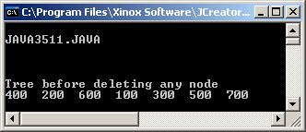
// Java3511.java
// This program sets the stage for the <DeleteDemo> class. In this program
// the classes and methods used to create and display the BST that will be used for
// the deletion program are shown first.
import java.util.*;
public class Java3511
{
public static void main(String args[])
{
int list[] = {400,200,600,100,300,500,700};
DeleteDemo tree = new DeleteDemo(list);
System.out.println("\n\nTree before deleting any node");
tree.levelTraverse();
System.out.println("\n\n");
}
}
class DeleteDemo
{
private TreeNode root;
public DeleteDemo(int[] list)
{
root = createBST(list);
}

Slide 82


Reference Warning Again
Always draw pictures anytime that you execute code of some linked data structure.
It is very easy to miss a link somewhere that will freeze up the program.

Slide 83
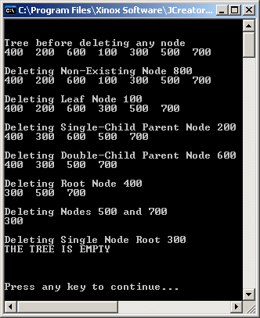
// Java3512.java
// This program tests the DeleteDemo class, which creates a binary search tree
// and tests every possible delete scenario.
import java.util.*;
public class Java3512
{
public static void main(String args[])
{
int list[] = {400,200,600,100,300,500,700};
DeleteDemo tree = new DeleteDemo(list);
System.out.println("\n\nTree before deleting any node");
tree.levelTraverse();
System.out.println("\n\nDeleting Non-Existing Node 800");
tree.deleteNode(800);
tree.levelTraverse();
System.out.println("\n\nDeleting Leaf Node 100");
tree.deleteNode(100);
tree.levelTraverse();
System.out.println("\n\nDeleting Single-Child Parent Node 200");
tree.deleteNode(200);
tree.levelTraverse();
System.out.println("\n\nDeleting Double-Child Parent Node 600");
tree.deleteNode(600);
tree.levelTraverse();
System.out.println("\n\nDeleting Root Node 400");
tree.deleteNode(400);
tree.levelTraverse();
System.out.println("\n\nDeleting Nodes 500 and 700");
tree.deleteNode(500);
tree.deleteNode(700);
tree.levelTraverse();
System.out.println("\n\nDeleting Single Node Root 300");
tree.deleteNode(300);
tree.levelTraverse();
System.out.println("\n\n");
}
}
deleteNode methods
on the next few slides

Slide 84
public void deleteNode(int item)
{
if (root != null)
{
TreeNode p = root;
TreeNode temp = root;
while (p != null && p.getValue() != item)
{
temp = p;
if (p.getValue() > item)
p = p.getLeft();
else
p = p.getRight();
}
if (p != null && p.getValue() == item)
{
if (p.getLeft() == null && p.getRight() == null) // must be a leaf node
deleteLeaf(p,temp);
else if (p.getLeft() == null || p.getRight() == null)
deleteParent1(p,temp); // must be a parent with one child
else
deleteParent2(p); // must be a parent with two children
}
}
}

Slide 85

public void deleteLeaf(TreeNode p, TreeNode temp)
{
if (p == temp) // one-node tree and leaf is also root
{
root = null;
}
else // multi-node tree with regular leaf
{
if (temp.getLeft() == p)
temp.setLeft(null);
else
temp.setRight(null);
}
}

Slide 86

public void deleteParent1(TreeNode p, TreeNode temp )
{
if (p == temp) // must delete root with one child
{
if (p.getLeft() == null)
root = root.getRight();
else
root = root.getLeft();
}
else
{
if (temp.getLeft() == p)
if (p.getLeft() == null)
temp.setLeft(p.getRight());
else
temp.setLeft(p.getLeft());
else
if (p.getLeft() == null)
temp.setRight(p.getRight());
else
temp.setRight(p.getLeft());
}
}

Slide 87
public void deleteParent2(TreeNode p)
{
TreeNode temp1 = p.getLeft();
TreeNode temp2 = p;
while (temp1.getRight() != null)
{
temp2 = temp1;
temp1 = temp1.getRight();
}
p.setValue(temp1.getValue());
if (p == temp2)
temp2.setLeft(temp1.getLeft());
else
temp2.setRight(temp1.getLeft());
}

Slide 88
AP Exam Alert
Thorough understanding of binary trees is a prerequisite for success on the AP Computer Science AB examination.

Slide 89
Different Types
of Binary Trees

Slide 90



Trees
A tree is a data structure that starts with
a root node that can be linked to 1 or more additional nodes. Furthermore, each node can be linked to one or more additional nodes.
Root
N1
N2
N3
N4
N5
N6
N7
N8
N9

Slide 91

Binary Trees
A binary tree is a tree data structure, in which each node can be linked to no more than 2 other nodes, called left child and right child.
Root
 | N1
 | N2
 | N3
 | N4
 | N5
 | N6
 | N7

Slide 92
Binary Expression Tree
A binary expression tree is a binary tree, in which each node contains an operand or operator of a mathematical expression. Each parent node contains an operator and each leaf contains an operand.
 | *
 | -
 | +
 | A
 | B
 | C
 | D

Slide 93
Binary Expression Tree Traversals
An in-order traversal displays (A-B)*(C+D)
An pre-order traversal displays * - A B + C D
An post-order traversal displays A B - C D + *
Look familiar?
Infix
Prefix
Postfix
 | *
 | -
 | +
 | A
 | B
 | C
 | D

Slide 94
Binary Search Tree
A binary search tree is a binary tree, in which the left child, (if it exists) contains a lesser value than the parent and the right child (if it exists) contains a greater value than the parent. A binary search tree is frequently also called an ordered binary tree. In most cases when the term binary tree is used in computer science, it usually is a binary search tree.
500
300
700
200
400
600
800
150
250
350
550
750
850
575
825

Slide 95
Full Binary Tree
A full binary tree is a binary tree, in which every parent has exactly two children. This means that every level is complete and that the tree contains (2^{N}-1) nodes, where N is the number of levels in the full binary tree. The example below has 4 levels.
This means that there are 2⁴-1 = 15 total nodes.
NOTE: As odd as it sounds, a tree with 0 nodes is considered full.
500
300
700
200
400
600
800
150
250
350
450
550
650
750
850

Slide 96
Complete Binary Tree
A complete binary tree is almost a full binary tree.
Every level of the tree is complete, except for the last level. Furthermore, the nodes in the last, or lowest level, are filled up from left to right.
500
300
700
200
400
600
800
150
250
350
450
550

Slide 97
Threaded Binary Tree
A threaded binary tree is a binary tree with an additional reference field in each node that is used to "point" from a child to a parent. In the drawing below, downward references are the conventional
references you have seen before, which represent a left and/or right reference from the parent to its two children. The upward references makes this binary tree a threaded binary tree. The upward references create a link from a child to a parent.
500
300
700
200
400
600
800
150
250
350
450
550

Slide 98
Threaded Binary Tree Declaration
Is this still a Binary Tree?
class ThreadedTree
{
private Object Value;
private int value;
private ThreadeTree left;
private ThreadedTree right;
private ThreadedTree parent;
.....
}

Slide 99
Heap and Max Heap
A heap is a complete binary tree with the property that every parent has a value that is greater or smaller than its children. If the parent's value is greater than the children's values, the heap is called a maxheap.
500
450
475
425
300
430
440
300
250
200
255
375

Slide 100
Min Heap
If the parent's value is smaller than the children's values, the heap is called a minheap.
100
200
300
250
275
350
375
400
450
315
395
385

Slide 101
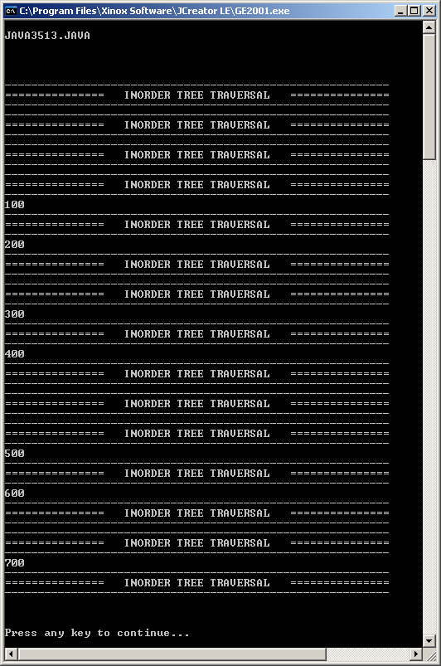
// Java3513.java
// This program demonstrates the consequence of casually placing some output statements
// in a recursive method.
import java.util.*;
public class Java3513
{
public static void main(String args[])
{
System.out.println("\nJAVA3513.JAVA\n");
System.out.println();
int[] list = {400,200,600,100,300,500,700};
TreeNode root = createBST(list);
System.out.println();
traverseInOrder(root);
System.out.println("\n\n");
}
public static void traverseInOrder(TreeNode p)
{
System.out.println("--------------------------------------------------------------------------------");
System.out.println("========== INORDER TREE TRAVERSAL ==========");
System.out.println("--------------------------------------------------------------------------------");
if (p != null)
{
traverseInOrder(p.getLeft());
System.out.println(p.getValue());
traverseInOrder(p.getRight());
}
}
}

Slide 102
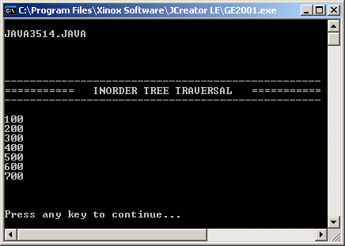
// Java3514.java
// This program solves the problem of the previous program by using an auxiliary method.
import java.util.*;
public class Java3514
{
public static void main(String args[])
{
System.out.println("\nJAVA3514.JAVA\n");
System.out.println();
int[] list = {400,200,600,100,300,500,700};
TreeNode root = createBST(list);
System.out.println();
displayTree(root);
System.out.println("\n\n");
}
public static void displayTree(TreeNode p)
{
System.out.println("--------------------------------------------------------------------------------");
System.out.println("========== INORDER TREE TRAVERSAL ==========");
System.out.println("--------------------------------------------------------------------------------");
System.out.println();
traverseInOrder(p);
}
public static void traverseInOrder(TreeNode p)
{
if (p != null)
{
traverseInOrder(p.getLeft());
System.out.println(p.getValue());
traverseInOrder(p.getRight());
}
}
}

Slide 103

To Auxiliary, or not to Auxiliary? That is the question.

Slide 104
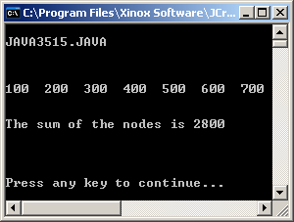
// Java3515.java
// This program uses an auxiliary method & a static sum to add the values in the nodes of a binary tree
import java.util.*;
public class Java3515
{
public static void main(String args[])
{
System.out.println("\nJAVA3515.JAVA\n");
System.out.println();
int[] list = {400,200,600,100,300,500,700};
TreeNode root = createBST(list);
System.out.println();
treeSum(root);
System.out.println("\n\n");
}
public static int sum; // allows accumulation in recursive method
public static void treeSum(TreeNode p)
{
sum = 0;
traverseInOrder(p);
System.out.println("The sum of the nodes is " + sum);
System.out.println();
}
public static void traverseInOrder(TreeNode p)
{
if (p != null)
{
traverseInOrder(p.getLeft());
System.out.print(p.getValue() + " ");
sum += p.getValue();
traverseInOrder(p.getRight());
}
}
}

Slide 105
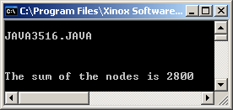
// Java3516.java
// This program uses a single <treeSum> method to handle the addition
// of the values in the binary tree nodes.
import java.util.*;
public class Java3516
{
public static void main(String args[])
{
System.out.println("\nJAVA3516.JAVA\n");
int[] list = {400,200,600,100,300,500,700};
TreeNode root = createBST(list);
System.out.println();
System.out.println("The sum of the nodes is " + treeSum(root));
System.out.println("\n\n");
}
public static int treeSum(TreeNode p)
{
if (p == null)
return 0;
else
return p.getValue() + treeSum(p.getLeft()) + treeSum(p.getRight());
}
}

Slide 106
APCS Exam Alert
If you are planning to take the AP Computer Science examination you will find it very beneficial to become comfortable with the return method style.
Many questions on past examinations
have proven that there is a considerable
emphasis on the ability to write a wide
range of different methods without the
use or need of any auxiliary methods.

Slide 107
Binary Tree
Methods

Slide 108
Method inOrder
This method will traverse a binary tree in the sequence left child --- parent --- right child.
If a binary tree is a binary search tree, the traversal will visit nodes from the smallest value to the greatest value.
public static void inOrder(TreeNode p)
{
if (p != null)
{
inOrder(p.getLeft());
System.out.println("Node value: " + p.getValue());
inOrder(p.getRight());
}
}

Slide 109
Method preOrder
This method will traverse a binary tree in the sequence:
Parent - - - Left Child - - - Right Child
public static void preOrder(TreeNode p)
{
if (p != null)
{
System.out.println("Node value: " + p.getValue());
preOrder(p.getLeft());
preOrder(p.getRight());
}
}

Slide 110
Method postOrder
This method will traverse a binary tree in the sequence:
Left Child - - - Right Child - - - Parent
public static void traverseInOrder(TreeNode p)
{
if (p != null)
{
postOrder(p.getLeft());
postOrder(p.getRight());
System.out.println("Node value: " + p.getValue());
}
}

Slide 111
Method levelOrder
This method traverses a binary tree by levels starting with the root level and then visiting nodes from left-to-right from the top level down to the lowest level.
It is the only iterative binary tree method.
It also uses a queue rather than a stack.
public static void levelOrder (TreeNode p)
{
Queue temp = new Queue();
if (p != null)
{
temp.add(p);
while (!temp.isEmpty())
{
p = (TreeNode) temp.remove();
System.out.print(p.getValue() + " ");
if (p.getLeft() != null)
temp.add(p.getLeft());
if (p.getRight() != null)
temp.add(p.getRight());
}
}
}

Slide 112
Method revOrder
This method will traverse a binary tree in the sequence right child --- parent --- left child.
If a binary tree is a binary search tree, the traversal will visit nodes from the greatest value to the smallest value.
public static void revOrder(TreeNode p)
{
if (p != null)
{
revOrder(p.getRight());
System.out.println("Node value: " + p.getValue());
revOrder(p.getLeft());
}
}

Slide 113
Method treeSum
This method returns the sum of values in all the nodes if the binary tree is non-empty and zero if the tree is empty.
public static int treeSum (TreeNode p)
{
if (p == null)
return 0;
else
return p.getValue() + treeSum(p.getLeft()) +
treeSum(p.getRight());
}

Slide 114
Method nodeCount
This method returns the number of nodes in a binary tree.
public static int nodeCount (TreeNode p)
{
if (p == null)
return 0;
else
return 1 + nodeCount(p.getLeft()) +
nodeCount(p.getRight());
}

Slide 115
Method leafCount
This method returns the number of leaves in a binary tree.
public static int leafCount (TreeNode p)
{
if (p == null)
return 0;
else
{
if ((p.getLeft() == null) && (p.getRight() == null))
return 1;
else
return leafCount(p.getLeft()) + leafCount(p.getRight());
}
}

Slide 116
Method copyTree
This method makes a duplicate of a binary tree and returns a reference to the root of the new binary tree.
public static TreeNode copyTree (TreeNode p)
{
TreeNode temp;
if (p == null)
return null;
else
{
temp = new TreeNode(p.getValue(), null, null);
temp.setLeft(copyTree(p.getLeft()));
temp.setRight(copyTree(p.getRight()));
return temp;
}
}

Slide 117
Method mirrorTree
This method creates a new binary tree that is a mirror tree of the argument. The method returns a reference to the root of the mirror tree.
public static TreeNode mirrorTree (TreeNode p)
{
TreeNode temp;
if (p == null)
return null;
else
{
temp = new TreeNode(p.getValue(), null, null);
temp.setLeft(mirrorTree(p.getRight()));
temp.setRight(mirrorTree(p.getLeft()));
return temp;
}
}

Slide 118
Method getHeight
This method returns the height of a binary tree.
public static int getHeight (TreeNode p)
{
if (p == null)
return 0;
else
{
if (getHeight(p.getLeft()) > getHeight(p.getRight()))
return 1 + getHeight(p.getLeft());
else
return 1 + getHeight(p.getRight());
}
}

Slide 119
Method isFull
This method determines if a binary tree is full.
The method returns true if the argument is the root of
a full binary tree, otherwise isFull returns false.
The method assumes that method getHeight exists.
What happens if the tree is empty? & Why is getHeight necessary?
public static boolean isFull (TreeNode p)
{
if (p == null)
return true;
else
return (isFull(p.getLeft()) && isFull(p.getRight()) &&
(getHeight(p.getLeft()) == getHeight(p.getRight()) );
}

Slide 120
Why getHeight is Necessary
500
300
700
200
400
600
800
If all you do is
check that every
parent node has
2 children, this
binary tree would
be considered full.
150
250
350
450
125
175

Slide 121
APCS Exam Alert
Students taking the "AB" examination frequently must answer a tree question.
In the majority of previous examinations this has been a binary tree question.
The program that follows
show a variety of methods
that were used on previous
APCS examinations.

Slide 122
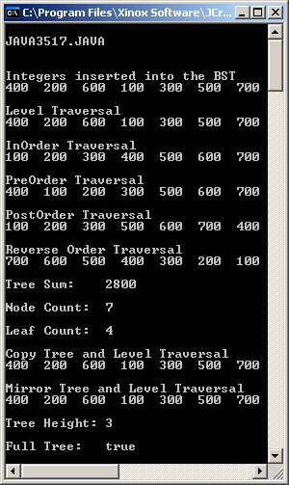
// Java3517.java
// This program combines a large variety of binary tree methods into
// one program, which displays tree statistics and tests the tree methods.
import java.util.*;
public class Java3517
{
public static void main(String args[])
{
System.out.println("\nJAVA3517.JAVA\n");
System.out.println();
int[] list = {400,200,600,100,300,500,700};
TreeNode root = createBST(list);
System.out.println("\nLevel Traversal");
levelOrder(root);
System.out.println("\n\nInOrder Traversal");
inOrder(root);
System.out.println("\n\nPreOrder Traversal");
preOrder(root);
System.out.println("\n\nPostOrder Traversal");
postOrder(root);
System.out.println("\n\nReverse Order Traversal");
revOrder(root);
System.out.println("\n\nTree Sum: " + treeSum(root));
System.out.println("\nNode Count: " + nodeCount(root));
System.out.println("\nLeaf Count: " + leafCount(root));
System.out.println("\nCopy Tree and Level Traversal");
copyTree(root); levelOrder(root);
System.out.println("\n\nMirror Tree and Level Traversal");
mirrorTree(root); levelOrder(root);
System.out.println("\n\nTree Height: " + getHeight(root));
System.out.println("\nFull Tree: " + isFull(root));
System.out.println();
}
All of these methods
have already been shown.

